Slide 1
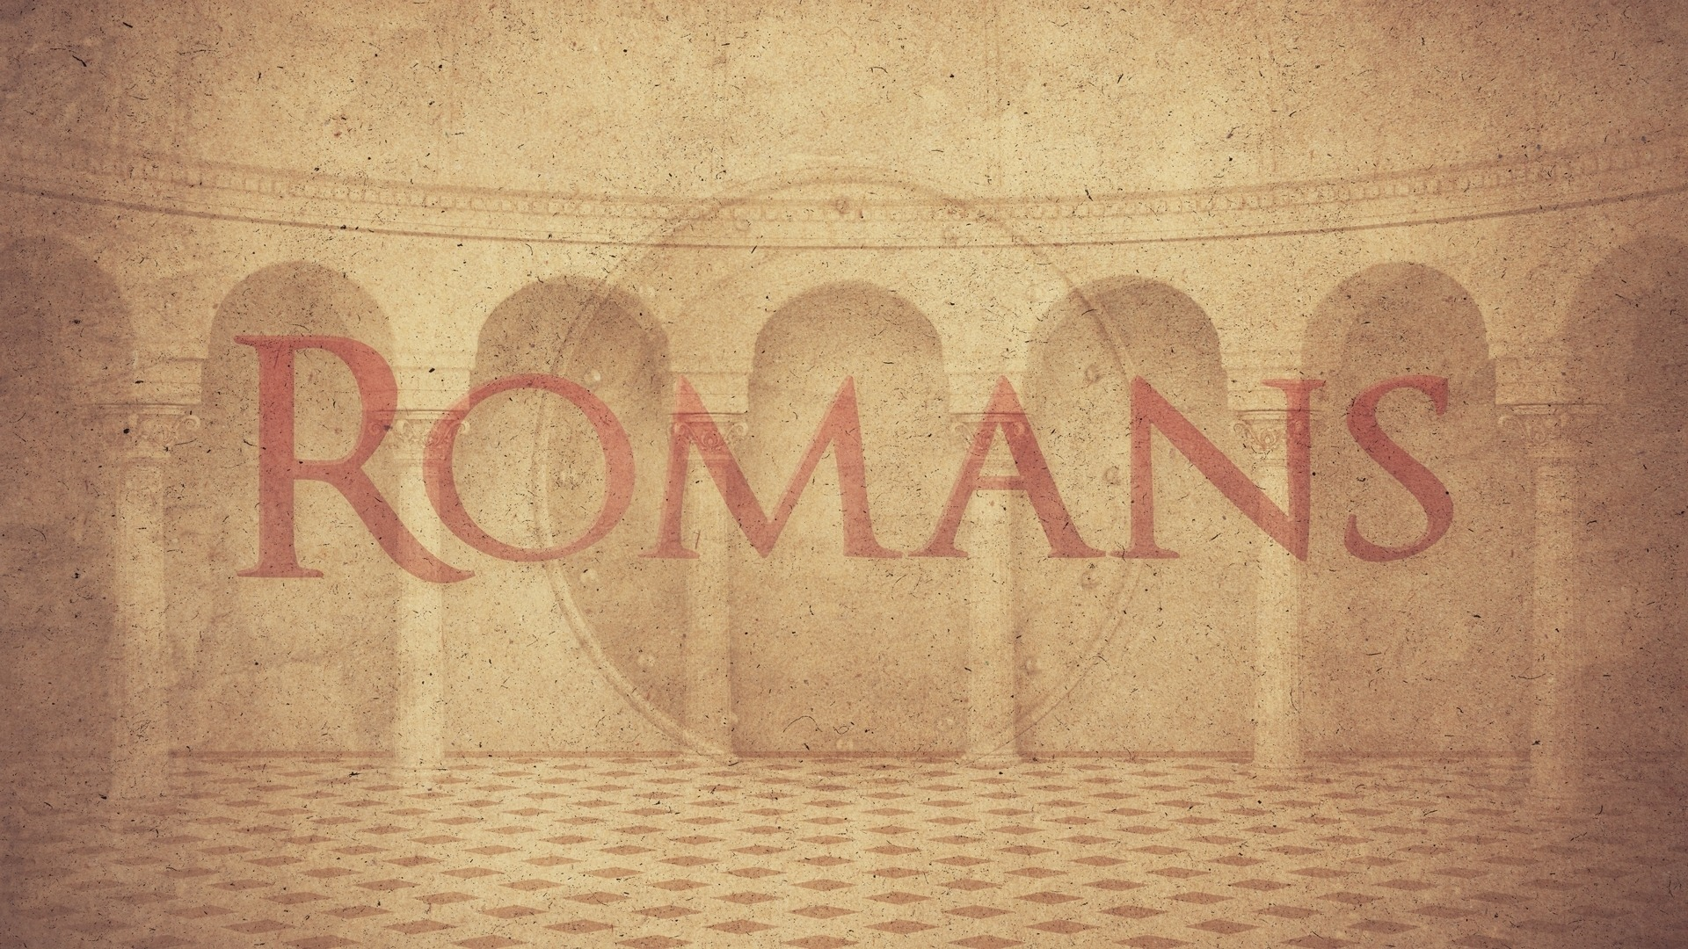
Chapter 14
Pursuing Peace

Slide 2
Recap of Romans 14 (Part 1)
Two types of people – weak and strong brothers
Issues used as examples – eating meats and holy days
Key Principles – People are God’s servants, not ours
Christians are trying to serve him in these matters
We all have to stand before God for our own actions

Slide 3
Question – What Issues Fit IN Here?
Only eating of meats and feast days
More than just eating of meats and feast days
It probably includes things that I feel like don’t belong here

Slide 5
Romans 14:13-15
Keys To Working Together
Therefore let us not judge one another anymore, but rather determine this—not to put an obstacle or a stumbling block in a brother’s way. I know and am convinced in the Lord Jesus that nothing is unclean in itself; but to him who thinks anything to be unclean, to him it is unclean. For if because of food your brother is hurt, you are no longer walking according to love. Do not destroy with your food him for whom Christ died.
Since we all will stand before God, my judgement is not important
I should be concerned about how another brother feels
Our consciences matter as much as the truth itself!
Love should guide all our actions in interpersonal relationships

Slide 6
Romans 14:16-19
Keys To Working Together
Our “opinions” can turn into our “problems”
It’s critical to be able to distinguish between important and non-important things
When we get these right, we will be approved by everyone
Our call is to pursue peace!
Therefore do not let what is for you a good thing be spoken of as evil; for the kingdom of God is not eating and drinking, but righteousness and peace and joy in the Holy Spirit. For he who in this way serves Christ is acceptable to God and approved by men. So then we pursue the things which make for peace and the building up of one another.

Slide 7
Romans 14:20-23
Keys to Working Together
Do not tear down the work of God for the sake of food. All things indeed are clean, but they are evil for the man who eats and gives offense. It is good not to eat meat or to drink wine, or to do anything by which your brother stumbles. The faith which you have, have as your own conviction before God. Happy is he who does not condemn himself in what he approves. But he who doubts is condemned if he eats, because his eating is not from faith; and whatever is not from faith is sin.
People’s relationships to God are more important than my liberties
We should forgo things that may cause our brother to sin
Everyone should have a good conscience before God
Our allegiance to God takes first precedent in everything

